Slide 1
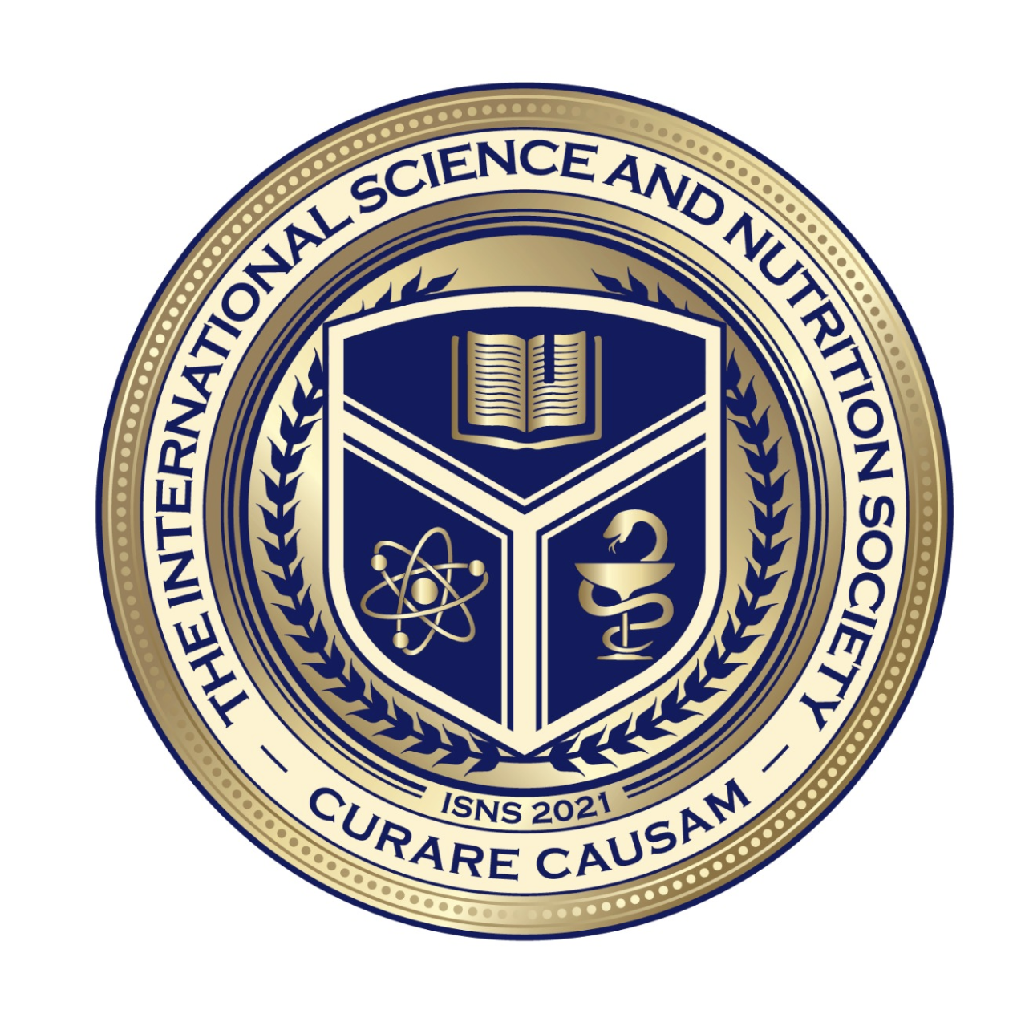
Science with Dr. Christina Rahm We will get started shortly.

Slide 2
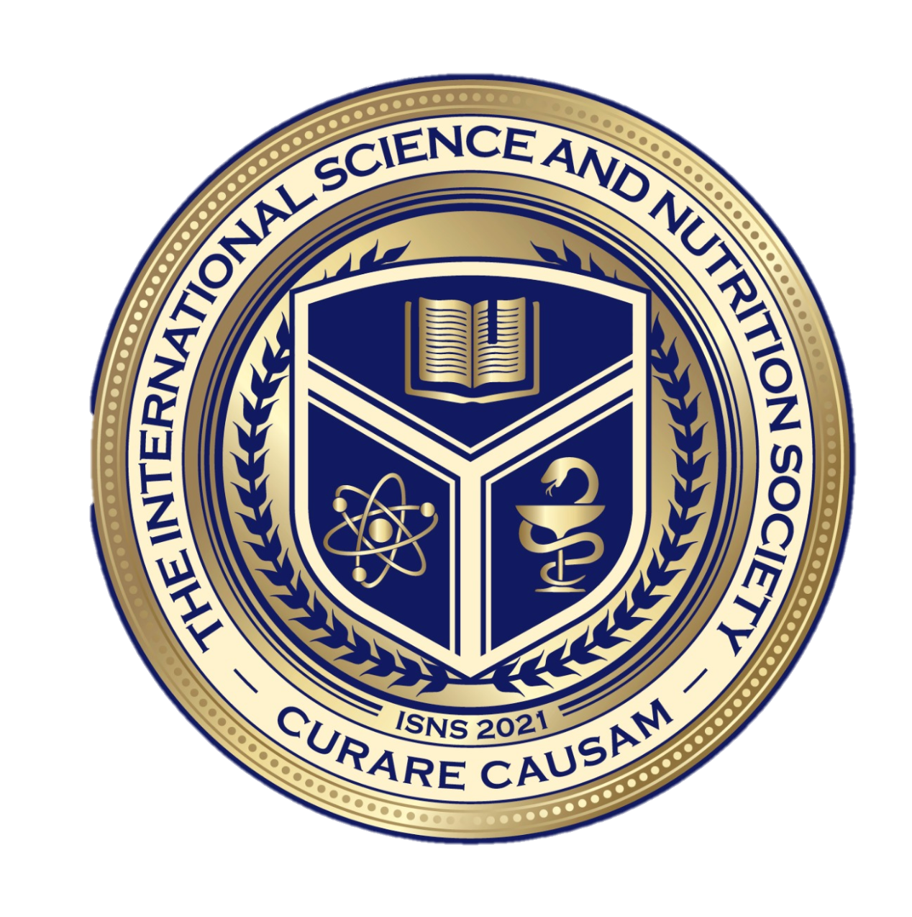
Medical Disclaimer:
The information provided is for educational purposes and is not intended as medical advice, or a substitute for the medical advice of a physician or other qualified health care professional.
You should not use this information for diagnosing a health or fitness problem or disease. You should always consult with a doctor or other health care professional for medical advice or information about diagnosis and treatment.
Notes:
The information provided is for educational purposes and is not intended as medical advice, or a substitute for the medical advice of a physician or other qualified health care professional. We do not aim to diagnose, treat, cure or prevent any illness or disease. You should always consult with a doctor or other health care professional for medical advice or information about diagnosis and treatment. The information in this presentation has not been evaluated by the Food & Drug Administration or any other medical body.

Slide 3
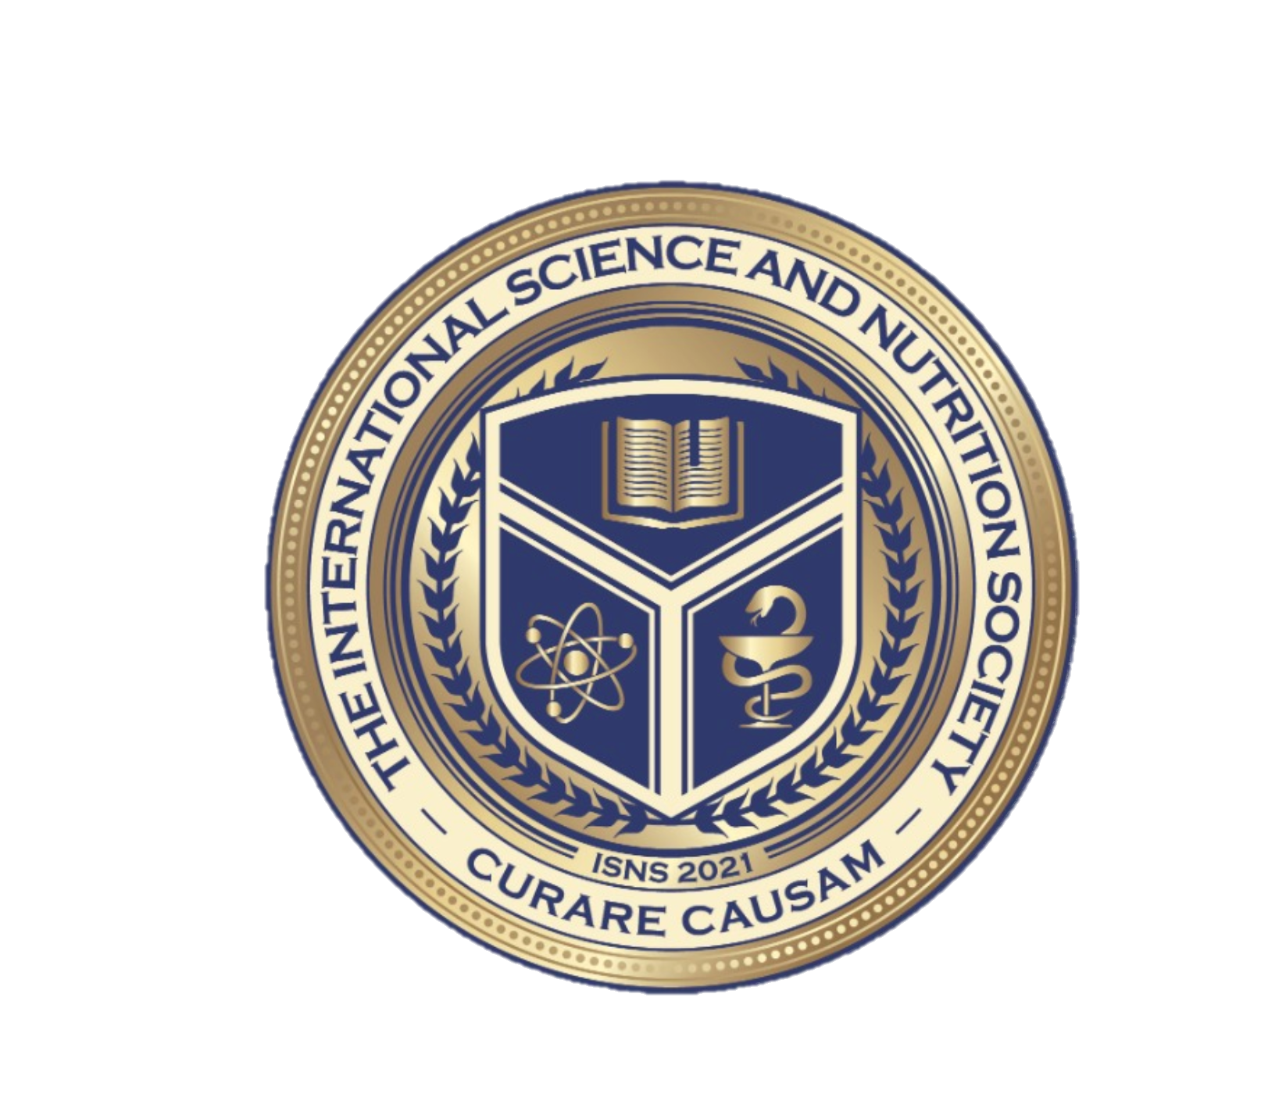
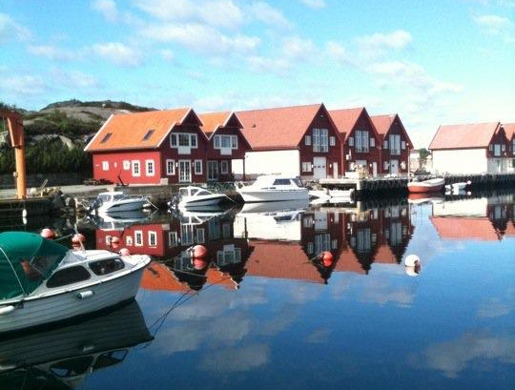
Dr. Dori Naerbo, Ph.D.
Notes:
Good morning, good afternoon, good evening…wherever you are in the world this is Dr. Dori Naerbo and I am your host on today’s call. For those of you who do not know me…I am a clinical researcher and author of several books.

Slide 4
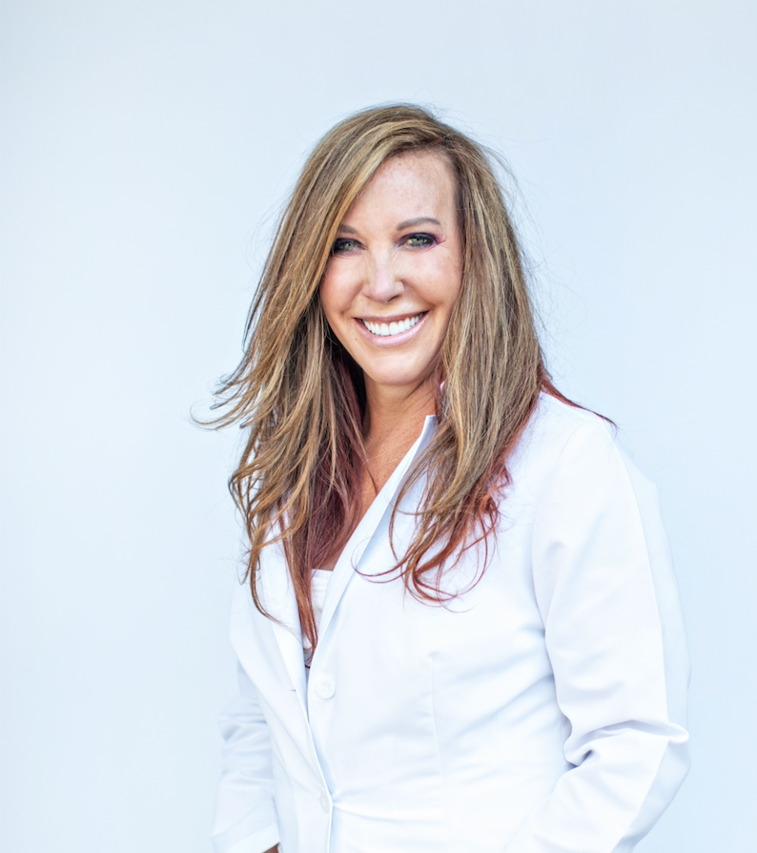
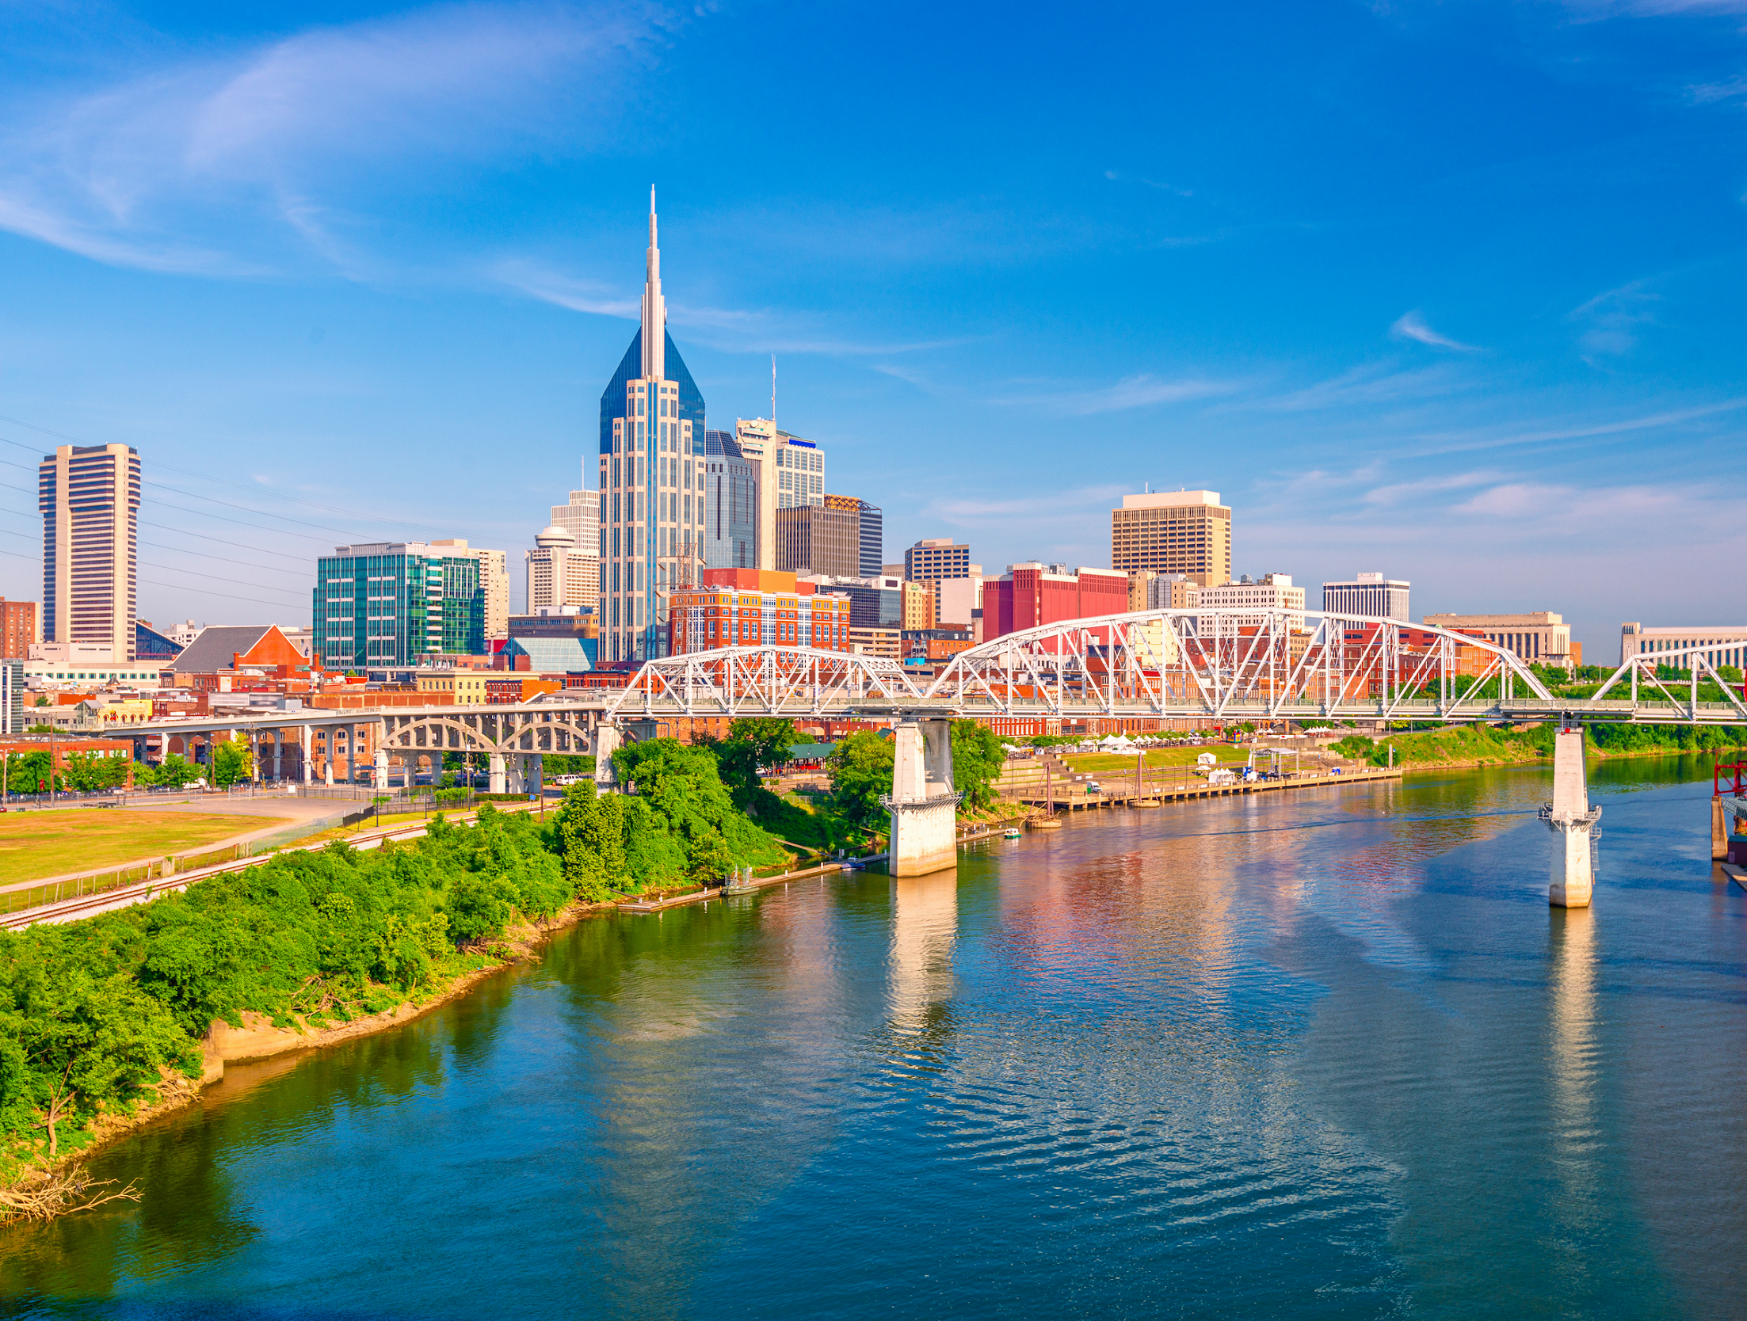
Dr. Christina Rahm CEO & Chief Science Officer

Slide 5
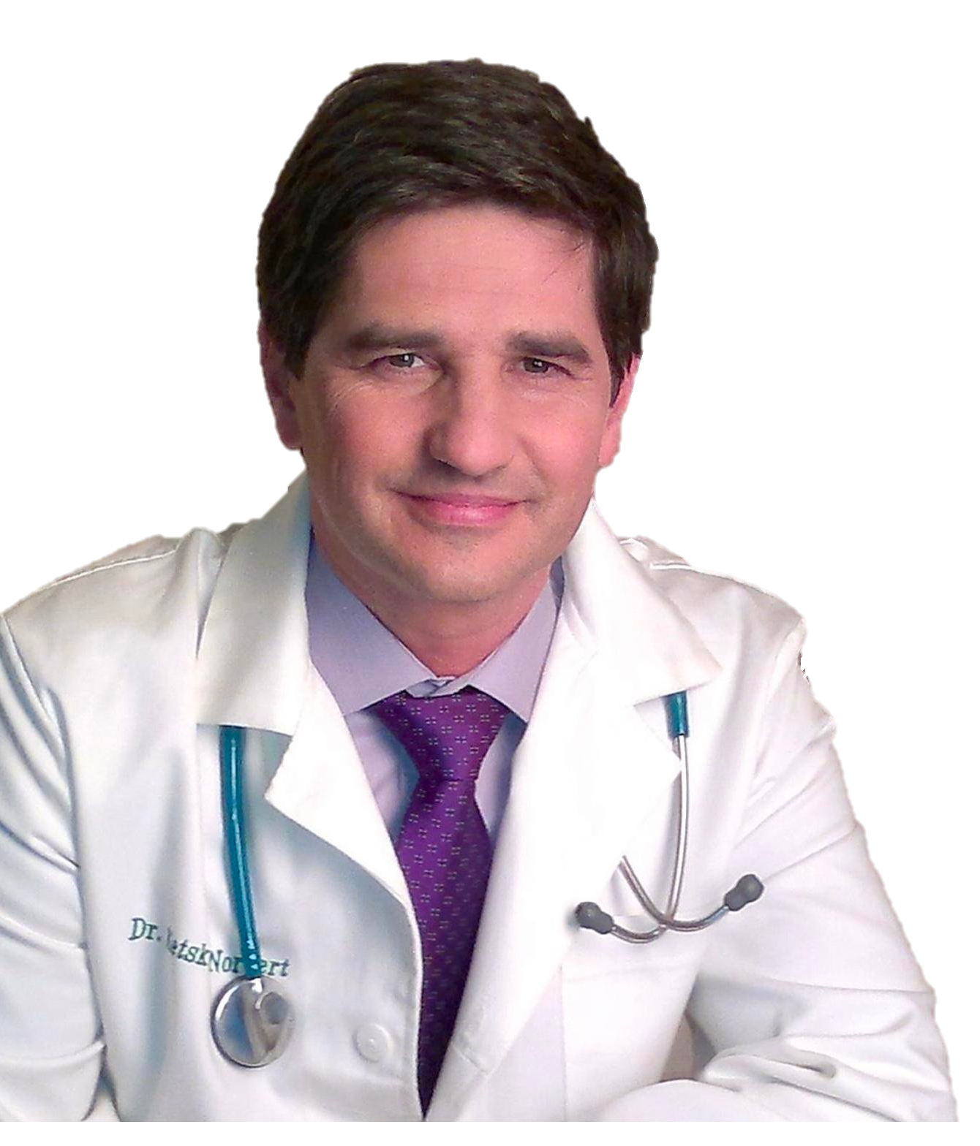
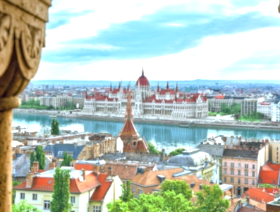
Dr. Norbert Ketskés, MD

Slide 6
ISNS Case Study Presented by: Dr. Norbert Ketskés

Slide 7
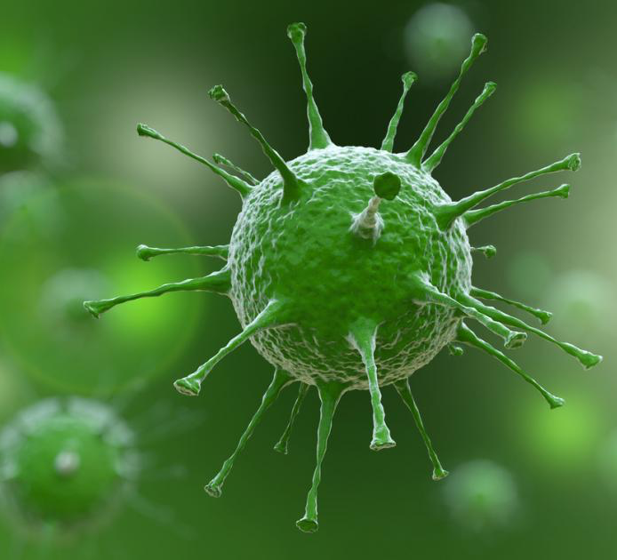
COVID-19
COVID-19 is the disease caused by SARS-CoV-2. Most people infected with the virus will experience mild to moderate symptoms. However, more serious complications and even death can occur to those with weakened immune systems or those old in age.
International Science and Nutrition Society – CURARE CAUSAM – ISNS 2021

Slide 8
COVID-19 SYMPTOMS
Fever
Cough
Sore Throat
Shortness of Breath
Runny Nose
Fatigue
Diarrhea
Vomiting
Nausea
Loss of Smell
Loss of Taste
International Science and Nutrition Society – CURARE CAUSAM – ISNS 2021

Slide 9
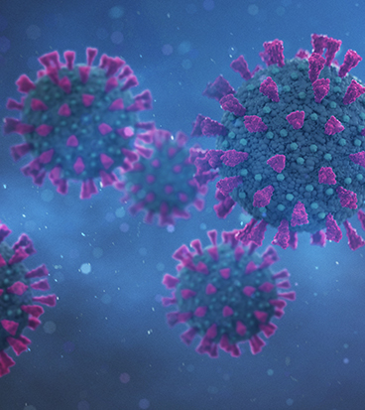
RISK FACTORS
Each of these factors can increase the risk of severe COVID-19 symptoms:
Older age
Lung conditions, including asthma
Heart disease
Brain and nervous system conditions
Diabetes and obesity
Cancer and certain blood disorders
Chronic kidney or liver disease
Mineral and Nutrient Deficiency
International Science and Nutrition Society – CURARE CAUSAM – ISNS 2021

Slide 10
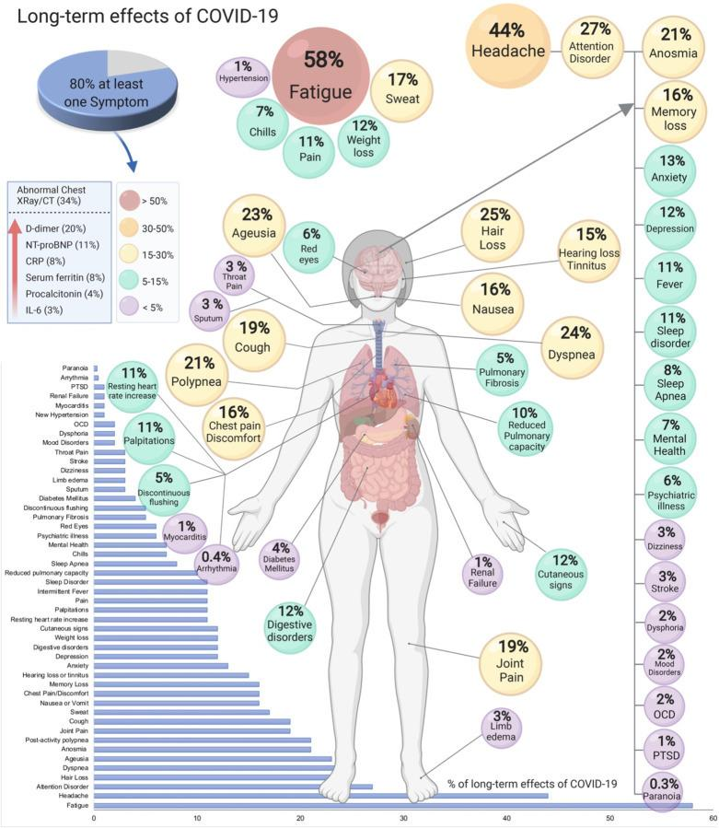
POST-COVID
Late residual symptoms and damage lasting more than 4 weeks after the onset of acute symptoms.
People who have had a mild acute infection may suffer for weeks or months with persistent symptoms.
Symptoms:
Shortness of breath, shortness of breath, chest pain, severe fatigue, dizziness, central and peripheral nervous system symptoms (e.g. stroke, polyneuropathy), numbness of limbs, headache, persistent loss or loss of sense of smell and taste.
Anxiety, depression (young people!!), sleep disturbance, "brain fog", dull, labored thinking
Predisposing factors:
Chronic cardiovascular disease, chronic respiratory disease, metabolic disease, obesity, smoking, extreme stress
International Science and Nutrition Society – CURARE CAUSAM – ISNS 2021
International Science and Nutrition Society – CURARE CAUSAM – ISNS 2021

Slide 11
Pro-BNP
Dr. James Januzzi (Harvard University and Massachusetts General Hospital, Boston) pointed out that elevated NT-proBNP may not only be a consequence of myocardial "stretch" due to overload, often described in the literature, but may also indicate a number of cardiac conditions, including "cytokine storm", which is very common in severe, critically ill COVID-19 patients.
In patients hospitalised for severe COVID-19, higher NT-proBNP at the time of admission is strongly suggestive of increased mortality. It also indicates a subgroup of patients in whom cardioprotective therapy is required.
International Science and Nutrition Society – CURARE CAUSAM – ISNS 2021
International Science and Nutrition Society – CURARE CAUSAM – ISNS 2021

Slide 12
PROPRIETARY BLENDS LEGEND
Proprietary blend I: Silica, Vitamin C, and Trace Minerals
Proprietary blend II: N-acetyl L-tyrosine, Anhydrous Caffeine, L-theanine, Velvet Bean Seed, Pine Bark, Curcumin, and Vitamin D
Proprietary blend III: Black seed Oil, Resveratrol, Turmeric, Raspberry Ketones, Apple Cider Vinegar, Aloe Vera, and D-Ribose
International Science and Nutrition Society – CURARE CAUSAM – ISNS 2021
International Science and Nutrition Society – CURARE CAUSAM – ISNS 2021

Slide 13
ISNS CASE STUDY: Post-COVID Syndrome
Patient: Male
Age: 40-year-old
History: A 40-year-old male A 40-year-old male suffered from COVID infection in May this year. He is a regular sportsman, non-smoker, and not obese. He experienced mild symptoms including fever, mild fatigue, and loss of taste and smell. After 2 weeks, these symptoms disappeared. His medication is Bisoprolol 5mg daily.
First consultation was middle of October
Symptoms: difficulty breathing with mild physical exertion, severe fatigue, dizziness, numbness in limbs, headache, sleep disturbance, "brain-fog", dull, difficult thinking, unable to do sports because she could not do sports.
Diagnostics (chest x-ray, ECG, cardiac ultrasound, laboratory tests)
High pro-BNP 360pg/ml (normal up to 125) and higher liver enzyme levels: ASAT-105 (U/L) (range 0-50), ALAT-192, range (0-50)
(Treatment and Results on Next Slide)
International Science and Nutrition Society – CURARE CAUSAM – ISNS 2021

Slide 14
ISNS CASE STUDY: Post-COVID Syndrome
Treatment/ Method:
Proprietary blend III :1 in the morning for 7 days, then 1.5 daily for 7 days, then 2, 1 in the morning and 1 in the evening
Proprietary blend II : 1 daily for 3 days, in the morning, then 2 daily, morning and afternoon,
Proprietary blend I : 2x5 drops, morning and evening, for 3 days, then every 3 days then increased by 1-1 drops every 3 days to 2x12
Results:
After 2 weeks, his fatigue and dyspnea decreased, and his headaches stopped. His dizziness and limb numbness greatly reduced and his thinking became fresher.
After 1 month his shortness of breath and dizziness had disappeared, and his fatigue was minimal. Limb numbness is only felt during heavy physical exertion. Sleep disturbance had also disappeared, and his thinking and concentration have improved.
Liver enzyme values have normalized: ASAT-52 (U/L) (range 0-50), ALAT-50, range (0-50)
The specific pro-BNP value has decreased from 360 to 170!
He was able to return to regular exercise
International Science and Nutrition Society – CURARE CAUSAM – ISNS 2021
International Science and Nutrition Society – CURARE CAUSAM – ISNS 2021

Slide 15
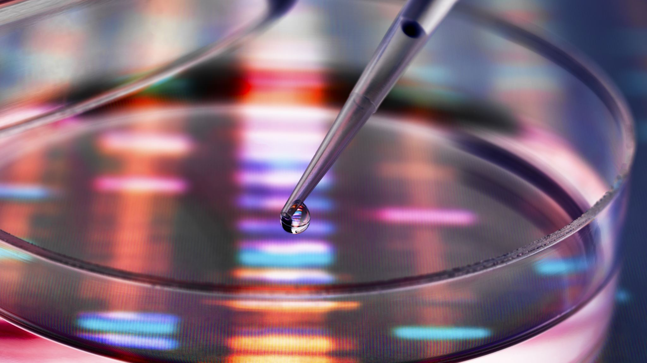
Research Studies
International Science and Nutrition Society – CURARE CAUSAM – ISNS 2021

Slide 16
Nutritional status of patients with COVID-19 By Jae Hyoung Im,ª Young Soo Je,^{b} Jihyeon Baek,ª Moon-Hyun Chung,^{c} Hea Yoon Kwon,^{a,⁎,1} and Jin-Soo Lee^{a,⁎,1}
Vitamin B1, B6, B12, vitamin D (25-hydroxyvitamin D), folate, selenium, and zinc levels were measured in 50 hospitalized patients with COVID-19.
The COVID-19 group showed significantly lower Vitamin D values than the healthy control group. Severe vitamin D deficiency was found in 24.0% of the patients in the COVID-19 group and 7.3% in the control group.
Among 12 patients with respiratory distress, 11 (91.7%) were deficient in at least one nutrient.
Overall, the study showed that 76% of the patients were vitamin D deficient and 42% were selenium deficient.
https://www.ncbi.nlm.nih.gov/pmc/articles/PMC7418699/
International Science and Nutrition Society – CURARE CAUSAM – ISNS 2021

Slide 17
Feasibility of Vitamin C in the Treatment of Post Viral Fatigue with Focus on Long COVID, Based on a Systematic Review of IV Vitamin C on Fatigue By Claudia Vollbracht^{1,2,*} and Karin Kraft
High-dose IV vitamin C combats overwhelming oxidative stress and restores endothelial and organ function. Vitamin C is vital for the phagocytosis of consumed neutrophils by macrophages.
Nine clinical studies with 720 participants were evaluated. Three of the four controlled trials observed a significant decrease in fatigue scores in the vitamin C group compared to the control group. Four of the five observational or before-and-after studies observed a significant reduction in pre–post levels of fatigue.
https://www.ncbi.nlm.nih.gov/labs/pmc/articles/PMC8066596/
International Science and Nutrition Society – CURARE CAUSAM – ISNS 2021

Slide 18
Turmeric as a Possible Treatment for COVID-19-Induced Anosmia and Ageusia By A. Bert Chabot ¹ and Margaret P ²
A 28-year-old man with mild intermittent asthma, but no other prior nasal or oral conditions, or recognized risk factors for anosmia or ageusia. He took a single dose of a capsule supplement containing 1000 mg of turmeric extract (95% curcuminoids). Twelve hours after taking the turmeric supplement, the subject reported experiencing a restoration of both smell and taste to intensity of 6/10 each, with 10/10 being achieved three days later.
A 25-year-old man with no chronic medical condition, prior nasal or oral conditions, or recognized risk factors for anosmia or ageusia. After the subject ingested 1000 mg of turmeric extract, he experienced complete restoration of smell and taste, with both senses rated 10/10, ten minutes after supplement ingestion.
https://www.ncbi.nlm.nih.gov/pmc/articles/PMC8502749/
International Science and Nutrition Society – CURARE CAUSAM – ISNS 2021

Slide 19
Revisiting pharmacological potentials of Nigella sativa seed: A promising option for COVID‐19 prevention and cure By Mohammad Nazrul Islam, 1 , 2 Khandkar Shaharina Hossain, 2 , 3 Partha Protim Sarker, 2 , 4 Jannatul Ferdous, 2 , 5 Md. Abdul Hannan, 2 , 6 , 7 Md. Masudur Rahman, 8 Dinh‐Toi Chu, 9 and Md. Jamal Uddincorresponding author 2 , 10
Previous studies in rats and guinea‐pigs showed that N. sativa seed extracts and its compounds such as thymoquinone, nigellone, and thymohydroquinone possessed significant antihistamine effects.
It was reported that N. sativa seeds have immuno‐potentiating properties in human T cells in vitro.
By inhibiting TANK‐binding kinase 1 (TBK1), thymoquinone downregulates interferon regulatory factor 3 (IRF‐3) activation, which has a critical role in viral and bacterial innate immune responses by regulating the production of Type I interferons.
A stimulatory effect on macrophages was also observed through a direct effect of N. sativa seeds.
https://www.ncbi.nlm.nih.gov/pmc/articles/PMC7675410/
International Science and Nutrition Society – CURARE CAUSAM – ISNS 2021

Slide 20
The use of D-ribose in chronic fatigue syndrome and fibromyalgia: a pilot study By Jacob E Teitelbaum 1, Clarence Johnson, John St Cyr
In this study, forty-one patients with a diagnosis of Fibromyalgia and chronic fatigue syndrome were given D-Ribose, a naturally occurring pentose carbohydrate, at a dose of 280 g.
The results showed that there was a significant improvement in energy, sleep, mental clarity, pain intensity, and well-being. Approximately, 66% of the patients experienced significant improvement while on D-Ribose, with an average energy increase of 45%.
D-Ribose has the potential to combat fatigue, reduce sleep disturbances, decrease brain fog, as well as improve overall well-being.
https://pubmed.ncbi.nlm.nih.gov/17109576/
International Science and Nutrition Society – CURARE CAUSAM – ISNS 2021
International Science and Nutrition Society – CURARE CAUSAM – ISNS 2021

Slide 21
Vitamins and Minerals for Energy, Fatigue and Cognition: A Narrative Review of the Biochemical and Clinical Evidence By Anne-Laure Tardy,^{1,*} Etienne Pouteau,¹ Daniel Marquez,² Cansu Yilmaz,³ and Andrew Scholey⁴
A 12-week trial of iron therapy with 198 women experiencing fatigue, showed that fatigue decreased in the iron treated group by 48% compared to the placebo group. It also increased hemoglobin and ferritin, when compared to the placebo.
Supplementation with 400 or 800 mg magnesium daily for 4 weeks has been shown to reduce the perception of fatigue in 25 women.
Several observational studies have suggested that a low plasma level of vitamin C or low vitamin C intakes were correlated to an increased incidence of depression or anxiety syndromes.
https://www.ncbi.nlm.nih.gov/pmc/articles/PMC7019700/
International Science and Nutrition Society – CURARE CAUSAM – ISNS 2021
International Science and Nutrition Society – CURARE CAUSAM – ISNS 2021

Slide 22
References
https://www.ncbi.nlm.nih.gov/pmc/articles/PMC7418699/
https://www.ncbi.nlm.nih.gov/labs/pmc/articles/PMC8066596/
https://www.ncbi.nlm.nih.gov/pmc/articles/PMC8502749/
https://www.ncbi.nlm.nih.gov/pmc/articles/PMC7675410/
https://pubmed.ncbi.nlm.nih.gov/17109576/
https://www.ncbi.nlm.nih.gov/pmc/articles/PMC7019700/
https://coronavirus.dc.gov/page/what-covid-19
https://www.cdc.gov/coronavirus/2019-ncov/covid-data/investigations-discovery/assessing-risk-factors.html
International Science and Nutrition Society – CURARE CAUSAM – ISNS 2021

Slide 23
Thank You For Joining Us Today!
International Science and Nutrition Society – CURARE CAUSAM – ISNS 2021
International Science and Nutrition Society – CURARE CAUSAM – ISNS 2021
International Science and Nutrition Society – CURARE CAUSAM – ISNS 2021

